Slide 1



Day 22
contact@anubhavtrainings.com
ABAP RESTFUL APPLICATION PROGRAMMING

Slide 2


Agenda – Day 22
What is Business Technology Platform ( BTP )?
SAP BTP learning Track
Setup SAP BTP Trial Account
Create Service Instance

Slide 3
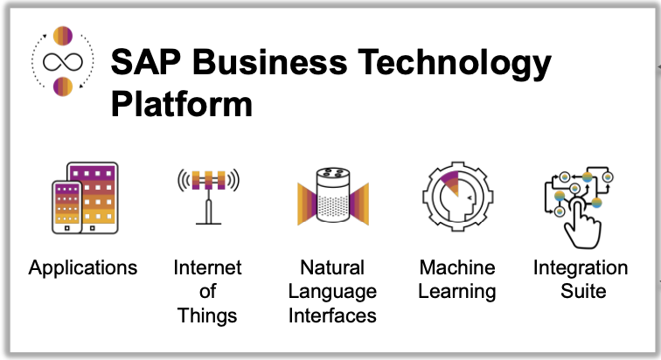
What is SAP BTP ?
SAP Business Technology Platform (SAP BTP) is the platform that powers you to become an intelligent enterprise through integration, extension, and data-to-value from all SAP and third-party application and data assets while ensuring your long-term success through agility, value-creation, and continual innovation.
BTP is an digital platform as a service to allow companies to build/integrate/extend existing solutions

Slide 4
Business Technology Platform
Apps
AaaS
Program
PaaS – Platform
Build Applications (Developers)
AWS, GCP, Azure, Oceancloud, cloud69, cloudflare, SCP
Web – Eclipse,Tomcat,Jboss…JRE
Visual Studio, ADS, Node.js, AtomIO
ABAP Platform
IAAS
Infrastructure as a Service
AWS, GCS, Azure
Network
HUB,Wifi,Router,LAN
Software stack
OS
Windows,Mac,Linux
Hardware
MB,HDD,RAM,Process,Screens…

Slide 5
SAP BTP Learning Track
1
Build New Solutions
1
Develop → Deploy → Deliver
2
2
Integrate
Integrate your existing Solutions
3
Extend
4
Extend your existing solutions by consuming data using API
3
4
Adapt new trends
Get to most latest technologies

Slide 6
Developer On-boarding
List of all the services which your co. is opting for, the subscription bills will be based on global account.
Global Account
Pricing point of view an a/c which sap will manage
01
02
Don’t forget to add members to your sub accounts according their nature of work.
Used for data center, services offered in a infrastructure, your team members are assigned inside sub account based on their work in co.
We need to create service plan to the sub account, to distribute the overall services offered at global account level.
Sub account
Service offerings based on regions
Space
Create to organize our development e.g. dev, qlt, prod
03
Out of all services available at sub account level, we can further distribute resources to the spaces using quota plan
https://www.sap.com/india/products/business-technology-platform.html

Slide 7

End of Day 22
Trainer: Anubhav Oberoy

Slide 8

Trainer: Anubhav Oberoy

Slide 9
THANK YOU
If you cannot do
great things, do small things in a great way.
Anubhav Oberoy
https://www.anubhavtrainings.com

Slide 10


We’re committed to empower you to be
Most Desirable Resource
through powerful training solutions.
We build the workforce of the future.
250+
Corporate Clients
30,000+
Learners Trained
25000+
Learners Placed
FREE WEBINARS
Sign up for free webinars with industry experts every fortnight!
Enroll Now!
Contact us today!
https://anubhavtrainings.com/

Slide 11




More from AnubhavTrainings.com

